Slide 1
EagleSat 2:
Memory Bit-Flip Experiment Overview and Development
April , 2019
by
Brennan Gray

Slide 2
Mission Overview
Detect bit flipping & memory degradation caused by radiation
Commercially available, consumer grade memory
  EEPROM
  Flash
  FRAM
  MRAM
  SRAM
Looking at differences in error rates between memory types

Slide 3
Instrument Description​
Instrument is comprised of an array of independent memory ICs​
Array comprised of eight chips of each type (EEPROM, Flash, MRAM, FRAM, SRAM)​
Physically arranged over two PCBs, with four of each chip on each board​
Interfaced with the payload computer by SPI (EEPROM, MRAM, FRAM, SRAM) and by SQI (Flash)

Slide 4
Hardware Selection
Decided to use only serial memory for ease of implementation, limiting hardware selection
  Number of serial memory ICs available less than parallel​
  Density of memory limited by interface – most applications requiring large memory amounts also require high bandwidth​
Highest possible memory density​
Smallest possible footprint for devices​

Slide 5
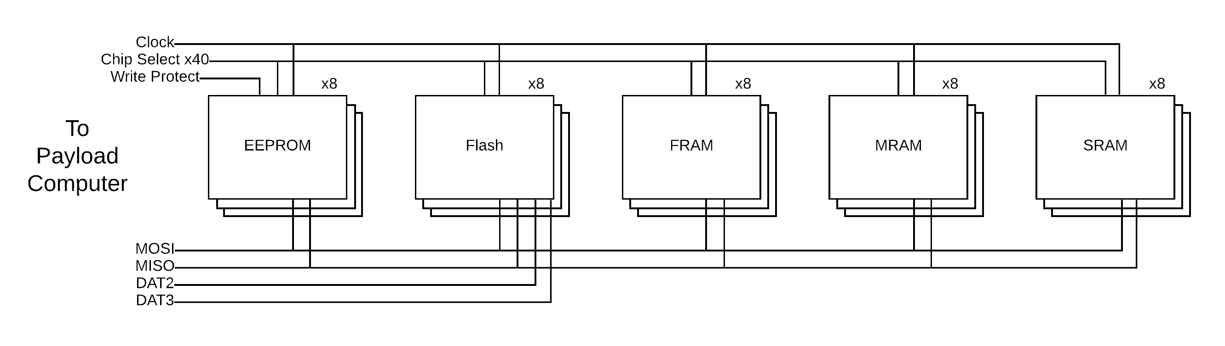
Architecture

Slide 6
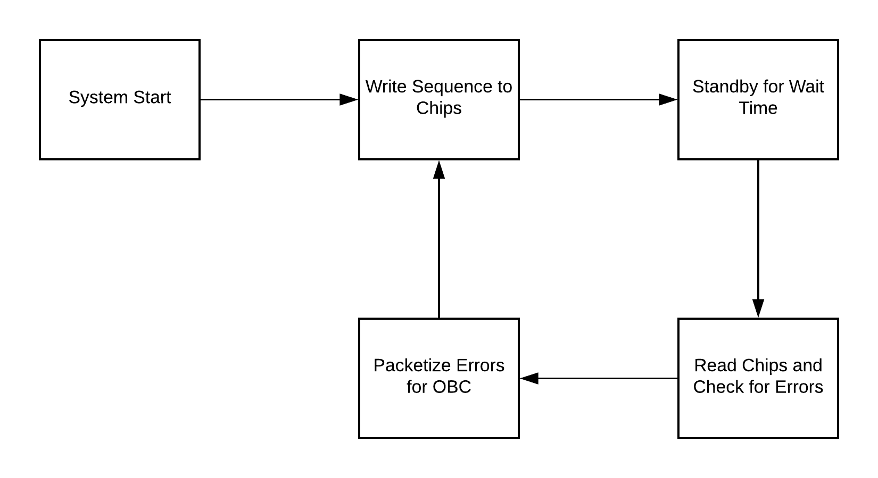
Instrument Operation​

Slide 7
Instrument Operation
A pseudorandom sequence is written to the memory array
  Sequence is not stored in memory during wait time
Chip array will be segmented with different write rates for different chips
Data received from instrument for each bit will include chip, byte address, bit address, and direction of error

Slide 8
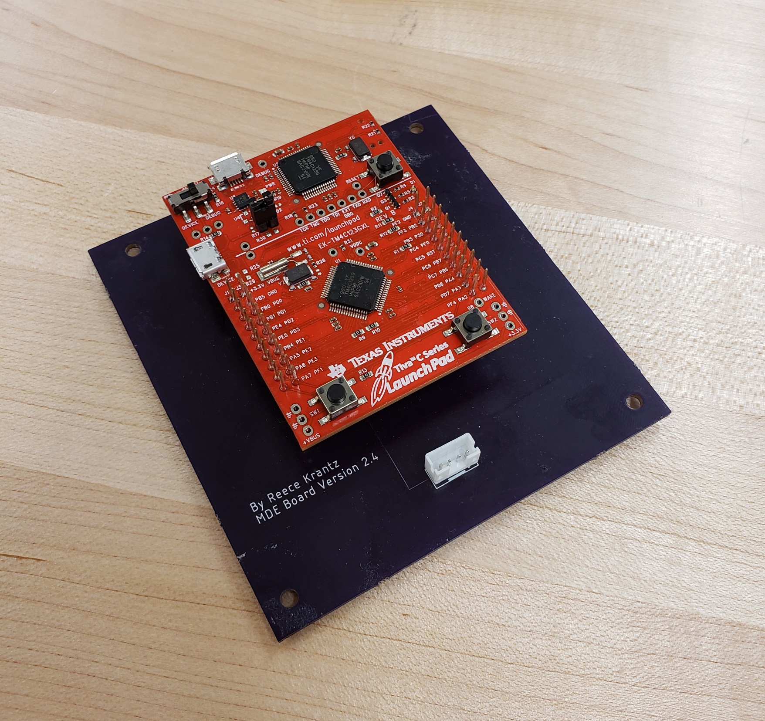
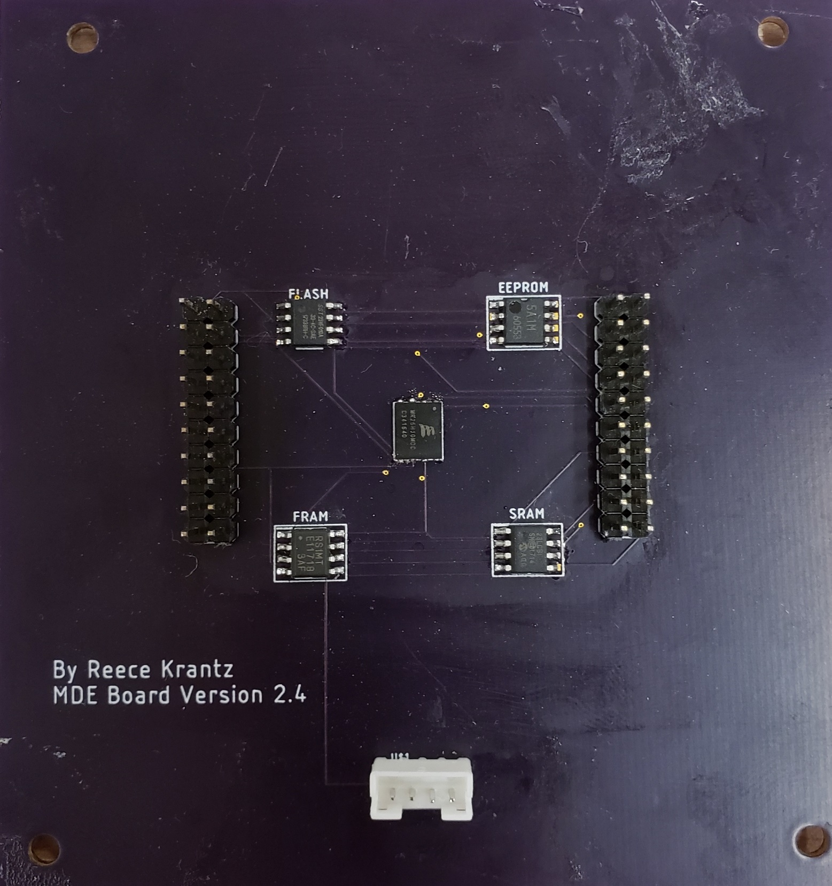
Prototyping

Slide 9
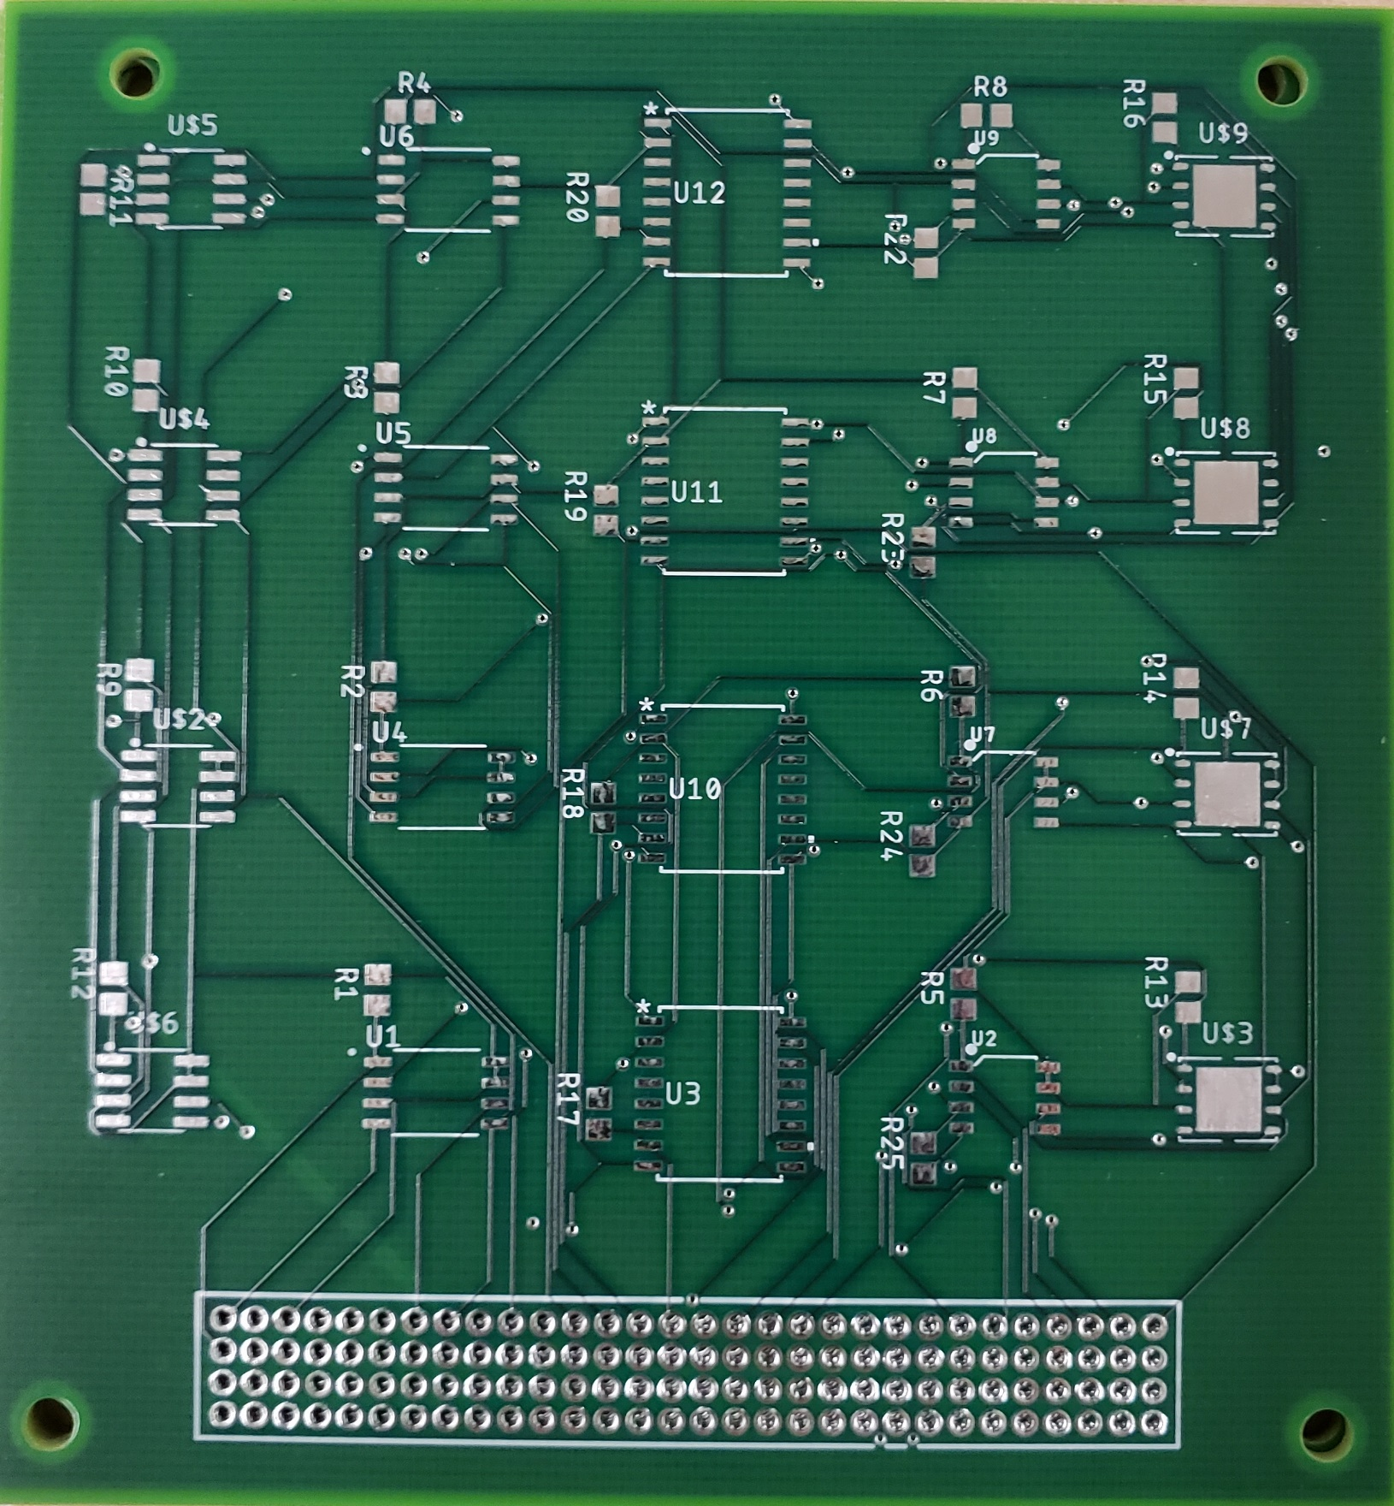
Prototyping

Slide 10
Testing
Error Seeding
  Program seeds errors while writing to memory array
  Error detection code consistently finds seeded errors
On-Ground Radiation Testing
  Available radiation sources limited
  Testing with Co-60 gamma ray source caused no SEUs
High Altitude Balloon Test
  Prototype functioned as intended throughout flight
  No SEUs observed during flight
Notes:
Plugs- In

Slide 11
Future Developments
Finish fabrication of flight hardware & creation of flight software
Rigorous testing of system as a whole
Determine cadence of read and write cycles, dependent on computational needs of other payload

Slide 12
Questions?
Brennan Gray
grayb8@my.erau.edu

Slide 13
Back-Up Slides

Slide 14
Hardware Selection
EEPROM: M95M02 (STMicroelectronics)
Flash: S25FL256LA (Cypress Semiconductor)
FRAM: CY15B104Q (Cypress Semiconductor)
MRAM: MR25H40 (Everspin Technologies)
SRAM: IS62WVS5128GBLL (Integrated Silicon Solutions Inc.)

